Slide 1

WELCOME

Slide 2
grocery MANAGEMENT SYSTEM
Under Guidance Of
POOJA MEHTA
SUBMITTED BY –
1. Rajshri Hinge
2. Priti Tayade
3. Monica Bodwade
4. Dhanashree Marathe

Slide 3
INTRODUCTION
Grocery Delivery Application is a low-price online Grocery store, which has many vital ranging products consumed in our everyday Breakfast, Meals & Dinners. We have Fresh Vegetables, Staples, Beverages, Personal care products & many other products needed daily. All the products on our website are distinguished based on their categories, which gives you the hassle-free shopping experience ever with minimum time spent for your shopping.
We guarantee you the best quality products with the lowest price. Right now we only serve you in Thane. To have a more convenient shopping experience, for you we deliver your selected products at your doorstep at your selected time slot. As in today's era every person sense short in time & also its hard to find if the consumable products are healthy/natural. So to tackle this issue we serve you with the finest & hand-picked products from all the categories, to save your time from the conventional shopping as well as from the problems like getting stuck in long queues, the parking fees to be paid, carrying you heavy shopping bags & etc.

Slide 4
TECHNOLOGIES USED
Spring Boot
MySQL
Postman
Angular

Slide 5
REQUIRED SPECIFICATIONS
Hardware Configuration –
Operating System: Windows 10
Solid state drive (SSD) : 512 GB
RAM: 4GB
Software Configuration –
Software IDE: Spring Tool Suite
Language: Java
Front End: Angular
Back End: MySQL, Postman

Slide 6
SPRING ANNOTATIONS
@RestController : Spring RestController annotation is used to create RESTful web services using Spring MVC. Spring RestController takes care of mapping request data to the defined request handler method. Once response body is generated from the handler method, it converts it to JSON or XML response.
@Autowired: The @Autowired annotation provides more fine-grained control over where and how autowiring should be accomplished.
@RequestMapping : @RequestMapping is one of the most common annotation used in Spring Web applications. This annotation maps HTTP requests to handler methods of MVC and REST controllers.
@Entity:The Entity annotation specifies that the class is an entity and is mapped to a database table.

Slide 7
SPRING ANNOTATIONS
@RequestBody: The @RequestBody annotation is applicable to handler methods of spring controller. spring should deserialize a request body into an object.
@OneToOne Mapping: The @OneToOne JPA annotation is used to map the source entity with the target entity, Hibernate maps the tables in your database to the Entity classes in your application.
@ ManyToOne Mapping: @Many-to-One mapping means that many instances of this entity are mapped to one instance of another entity.

Slide 8
SPRING ANNOTATIONSa
@Table: The Table annotation is used to create a table in database.
@JoinColumn: @JoinColumn is used to specify a column for joining an entity association or element collection.
@PutMapping :@PutMapping is used for update the records.
@PostMapping: @PostMapping is used to create a resource Mapping.
@GetMapping: @GetMapping is used to read all the inserted records.
@DeleteMapping : @DeleteMapping is used to delete the records.
@PathVariable: The Path Variable annotation is used to extract the value from the URL.
@RequestParam: @RequestParam annotation is used to read the form data and bind it automatically to the parameter present in the provided method.

Slide 9
SPRING ANNOTATIONS
@ExceptionHandler:The @ExceptionHandler is an annotation used to handle the specific exceptions and sending the custom responses to the client.
@ControllerAdvice: A controller advice allows you to use exactly the same exception handling techniques but apply them across the whole application, not just to an individual controller. You can think of them as an annotation driven interceptor.
Handles Resource Not Found Exception
Handles Method Argument Not Valid Exception

Slide 10
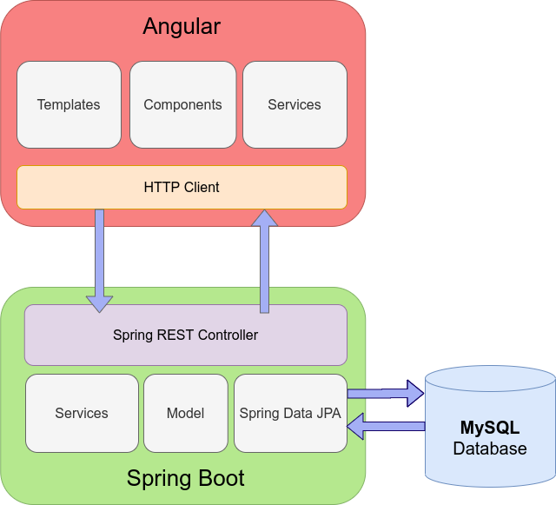
SYSTEM FLOW DIAGRAM

Slide 11
MODULEs
The System Contains 2 Modules
ADMIN – Registration, login, Add Product, Product list.
CLIENT – Signup, login ,Product List, Add To Card, Place Order, Payment.

Slide 12
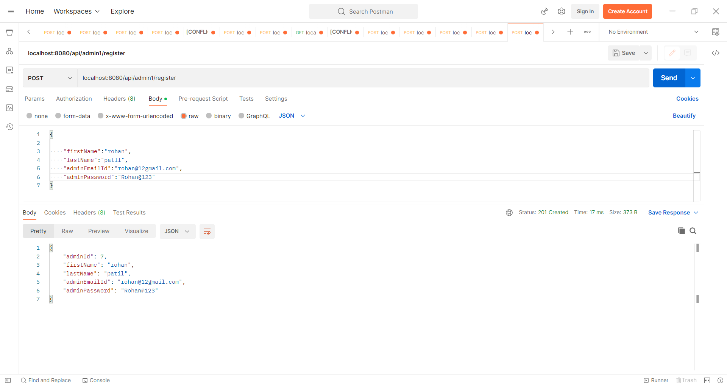
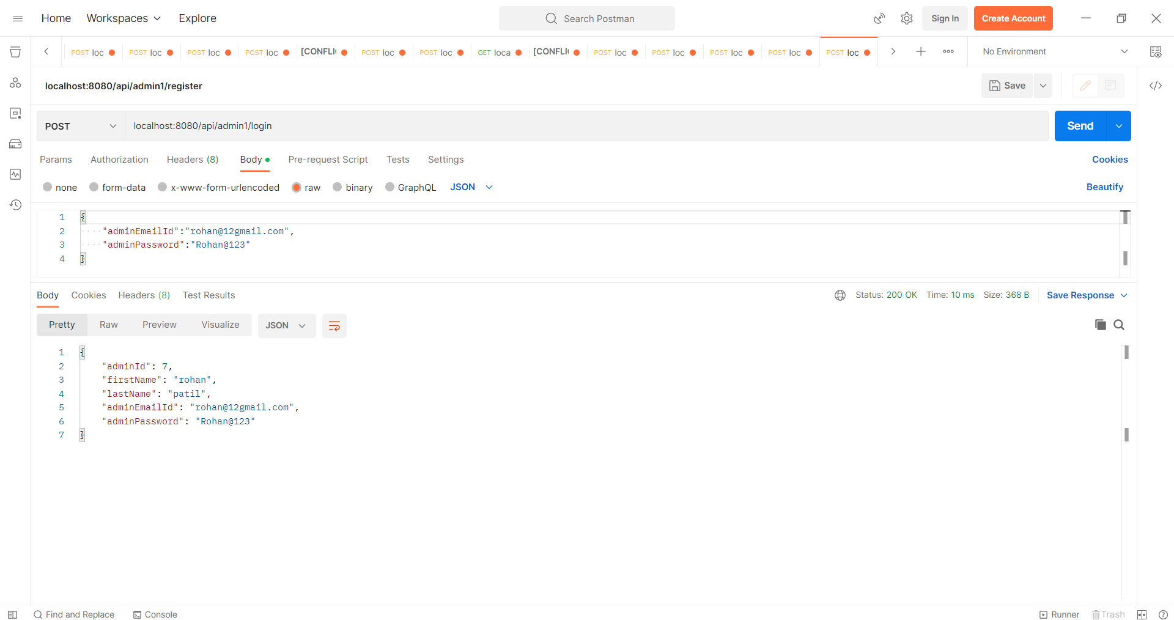
OUTPUT SCREENSHOTS IN POSTMAN
Admin Registration - Admin Login -

Slide 13

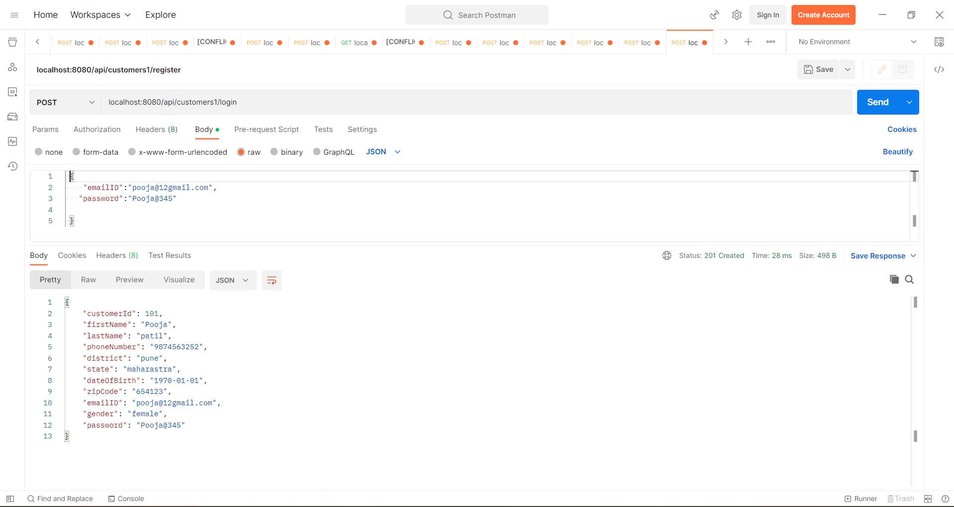
Output -
Client Registration- Client Login -

Slide 14
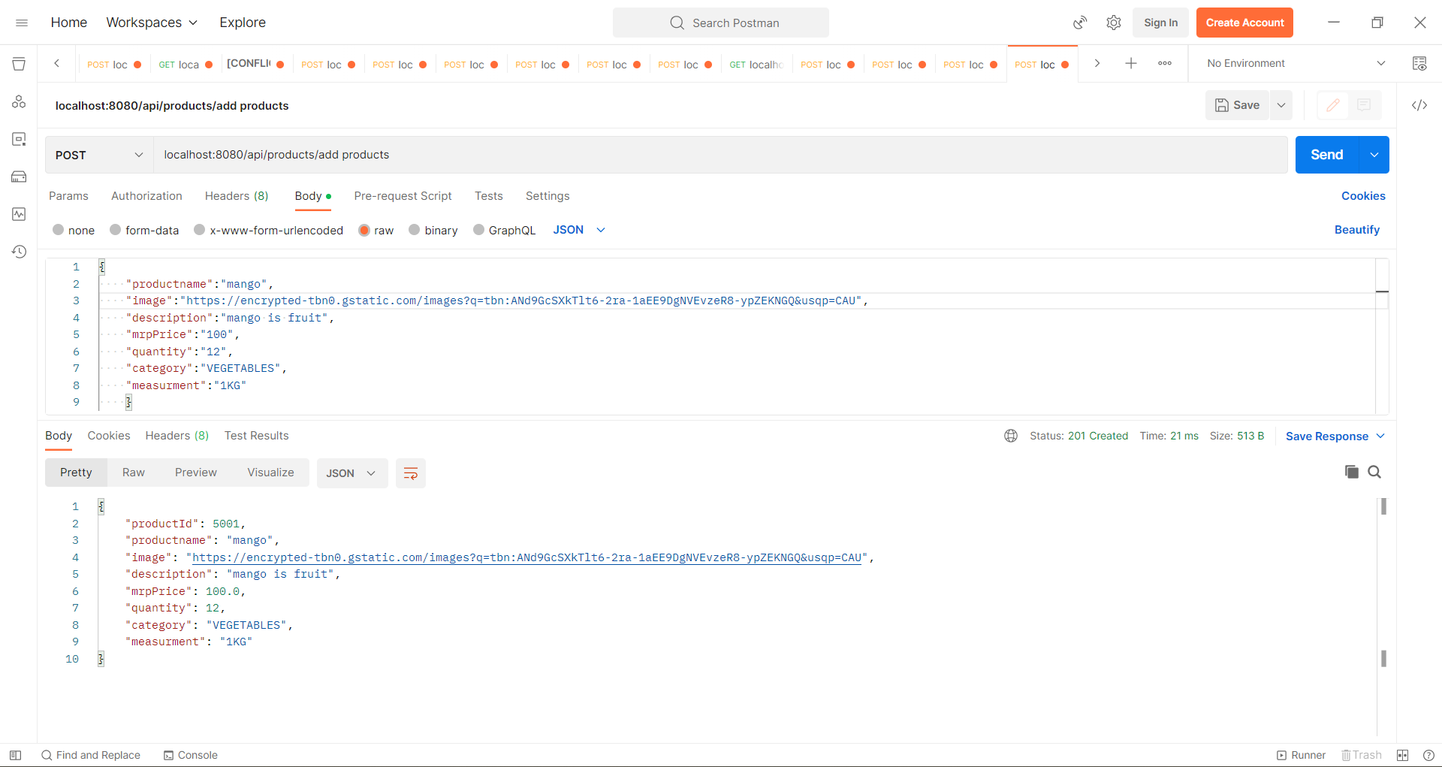
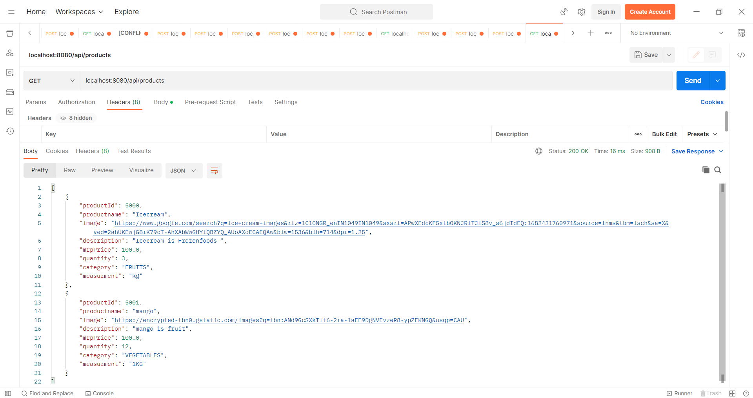
Output -
Admin Add Product – Admin Product List -

Slide 15
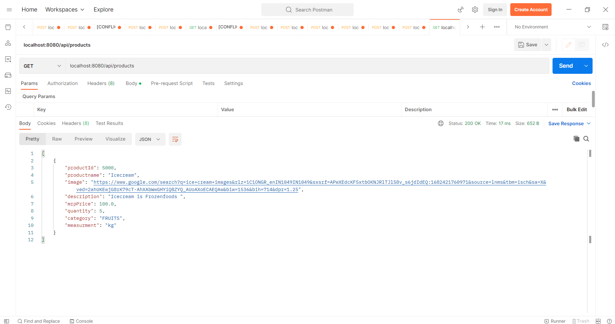
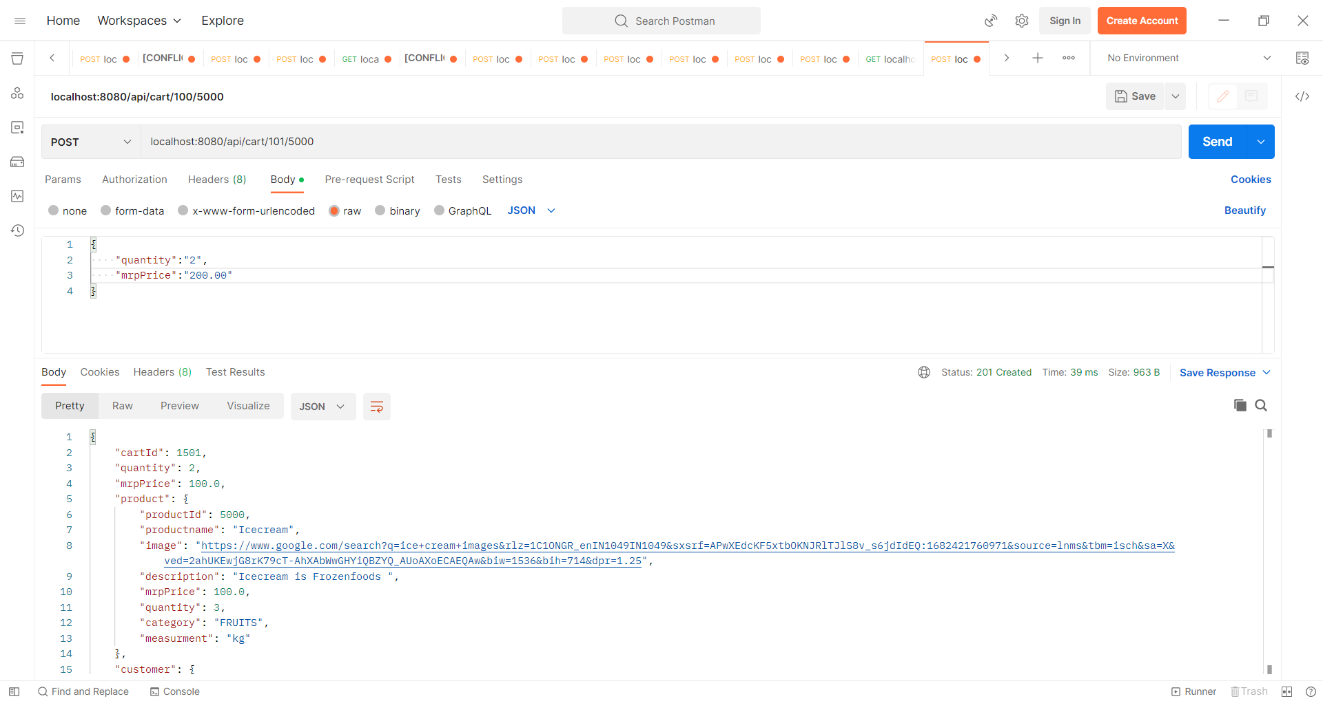
Output -
Client View Product – Client Add Cart -

Slide 16
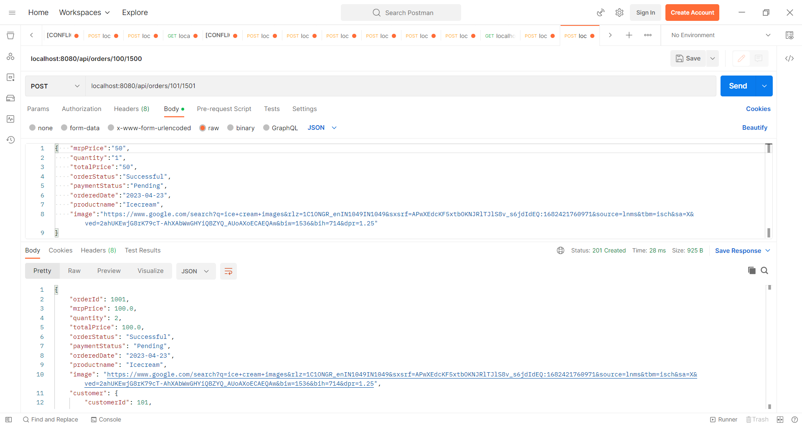
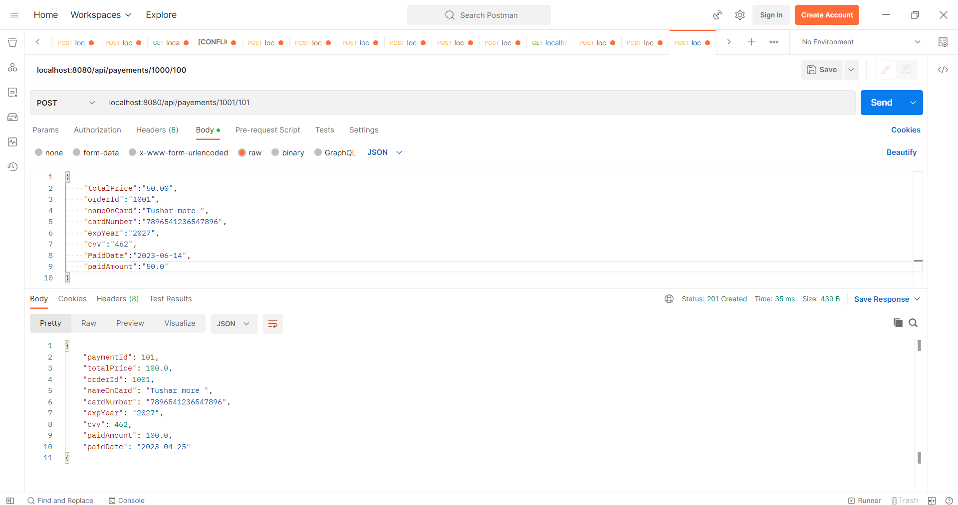
Output -
Place Order– Payment

Slide 17
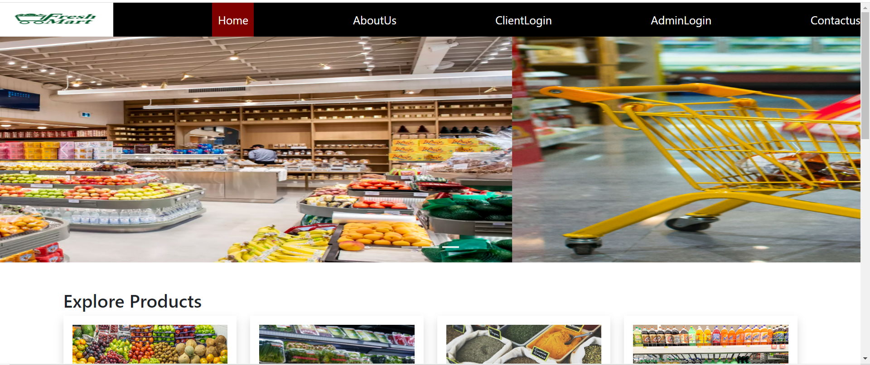
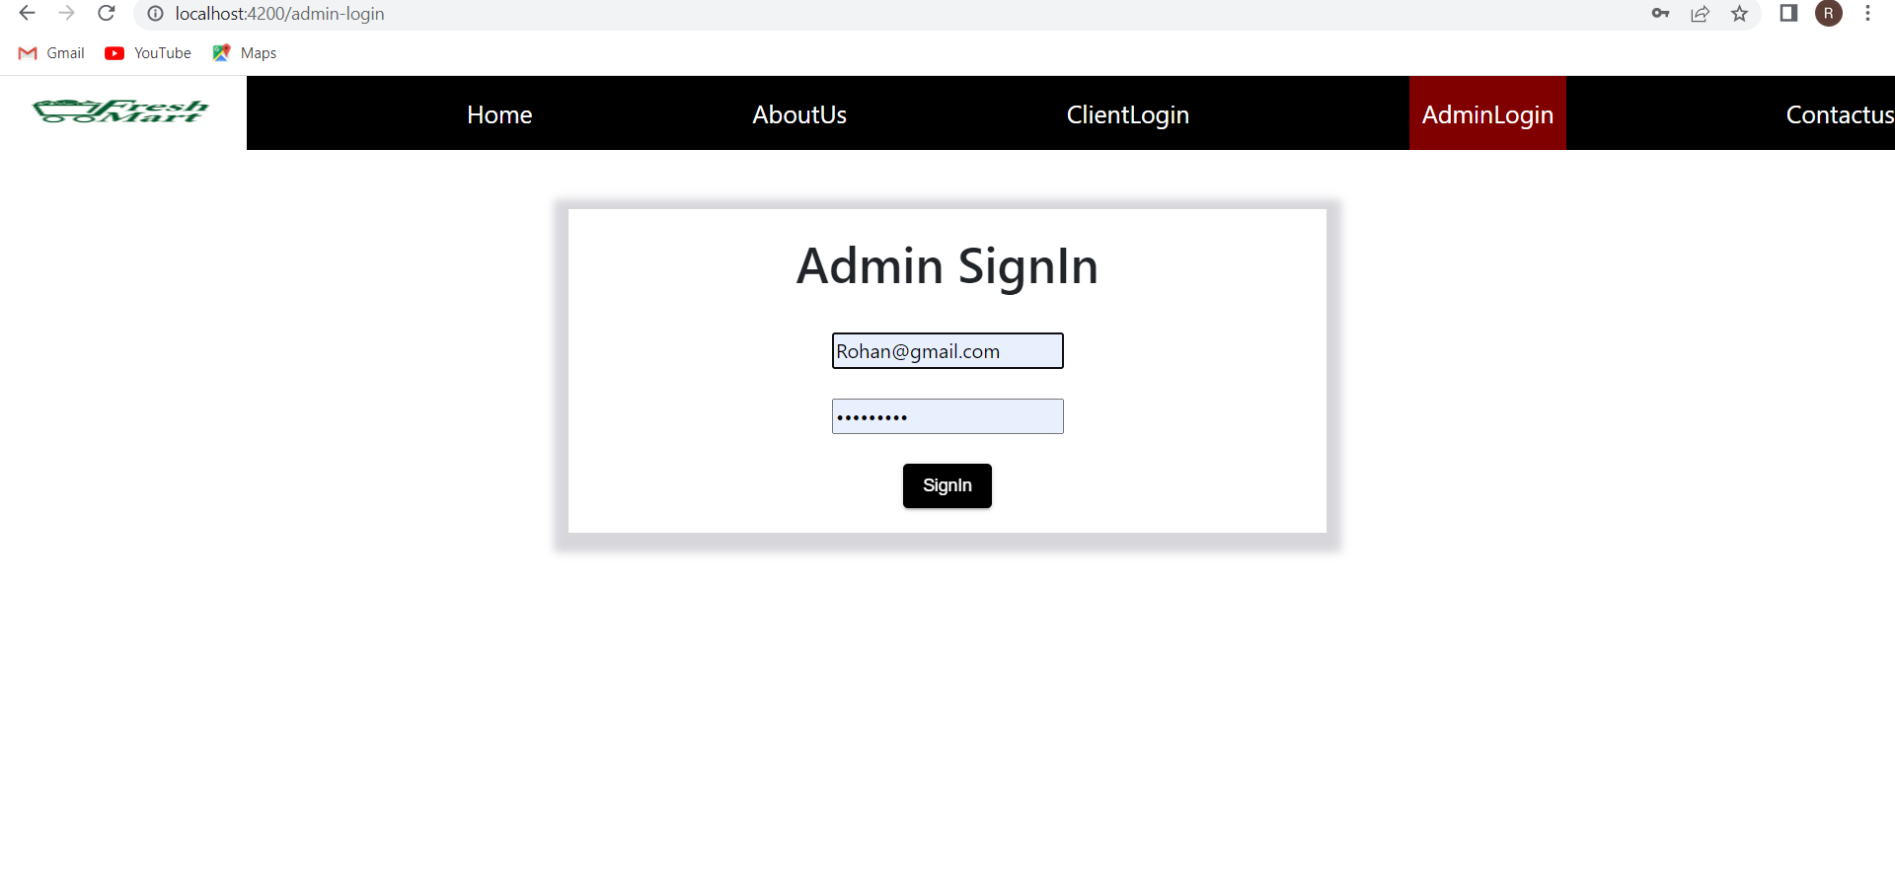
Browser outputs -
Home page –
Admin Login

Slide 18
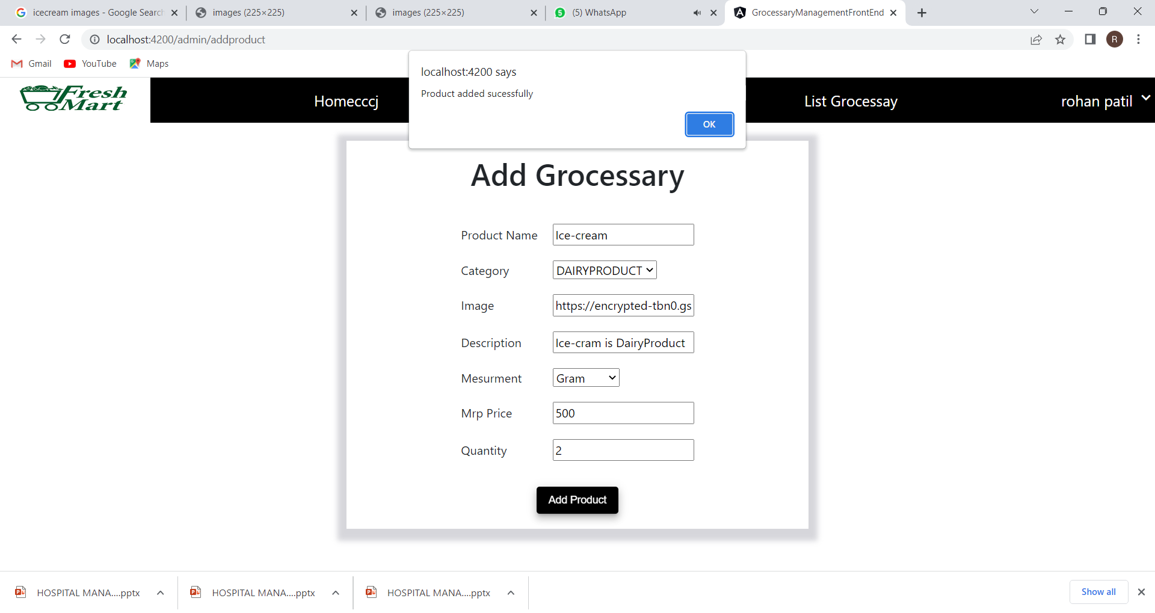
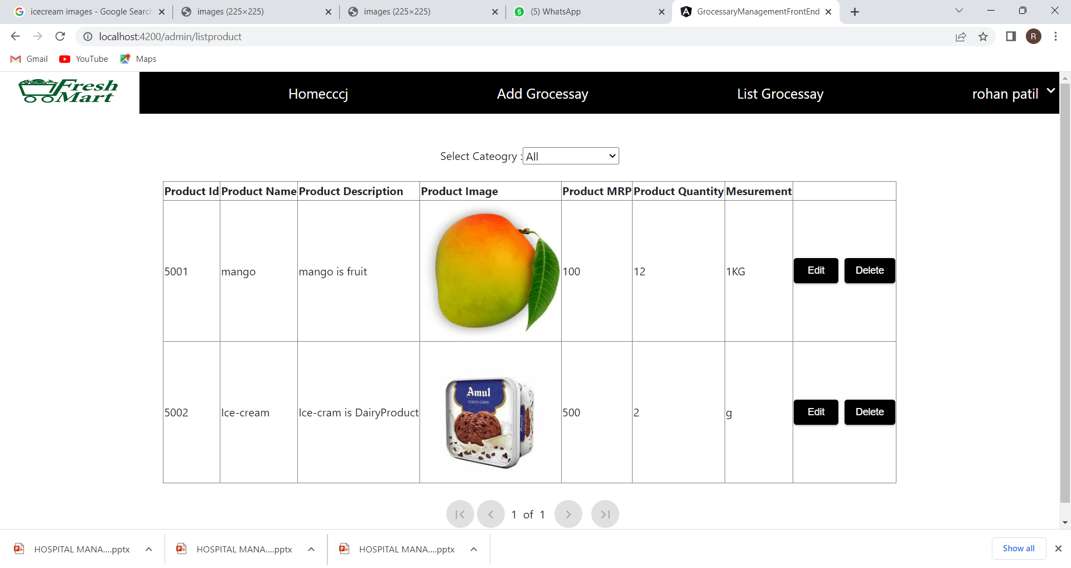
Output
Admin Add product Admin List Product

Slide 19
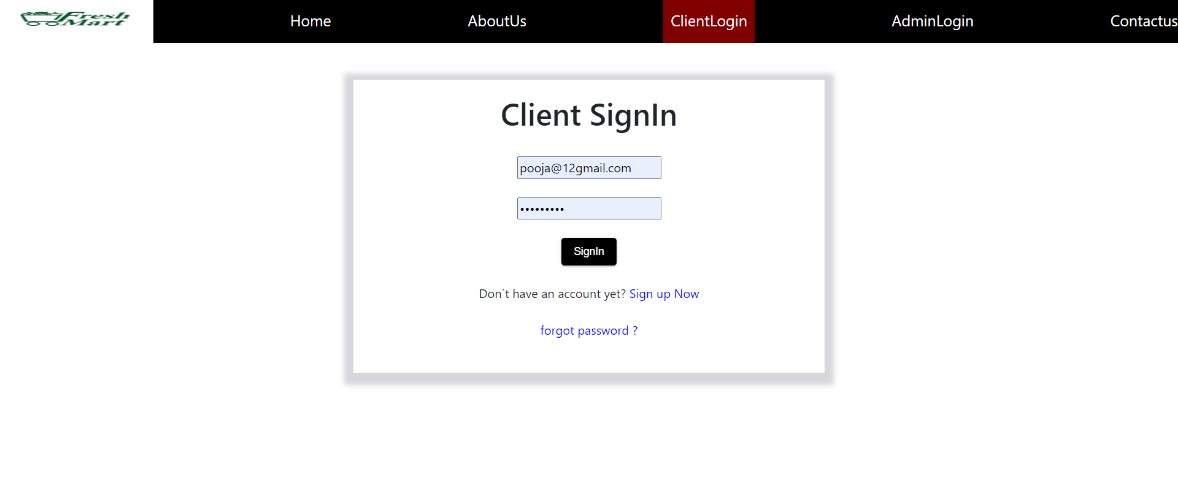
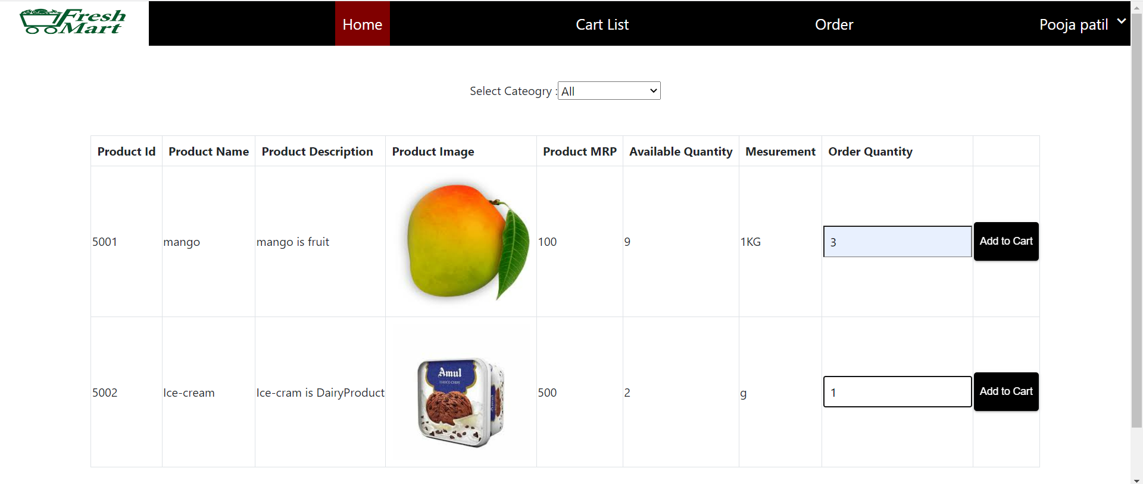
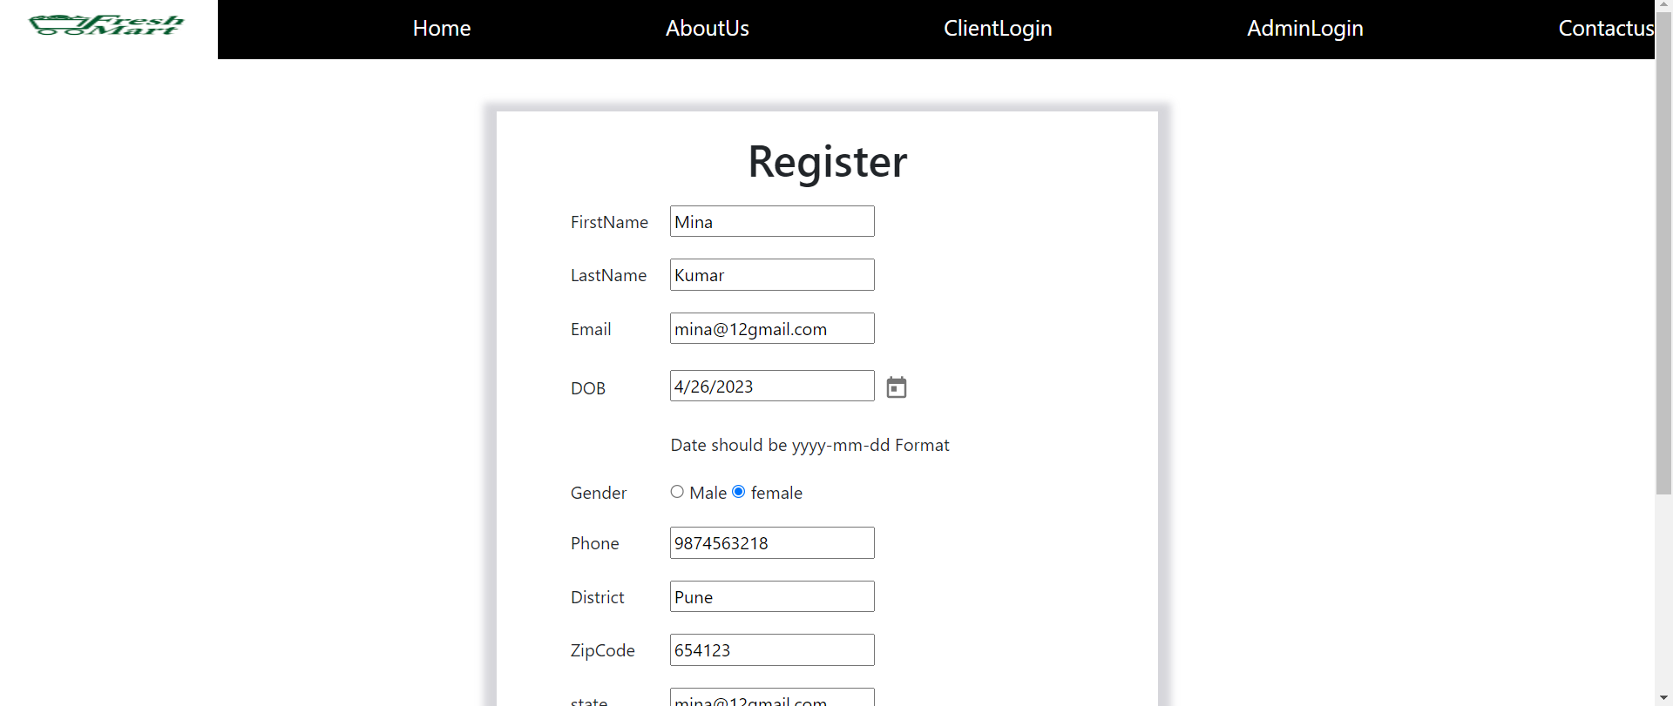
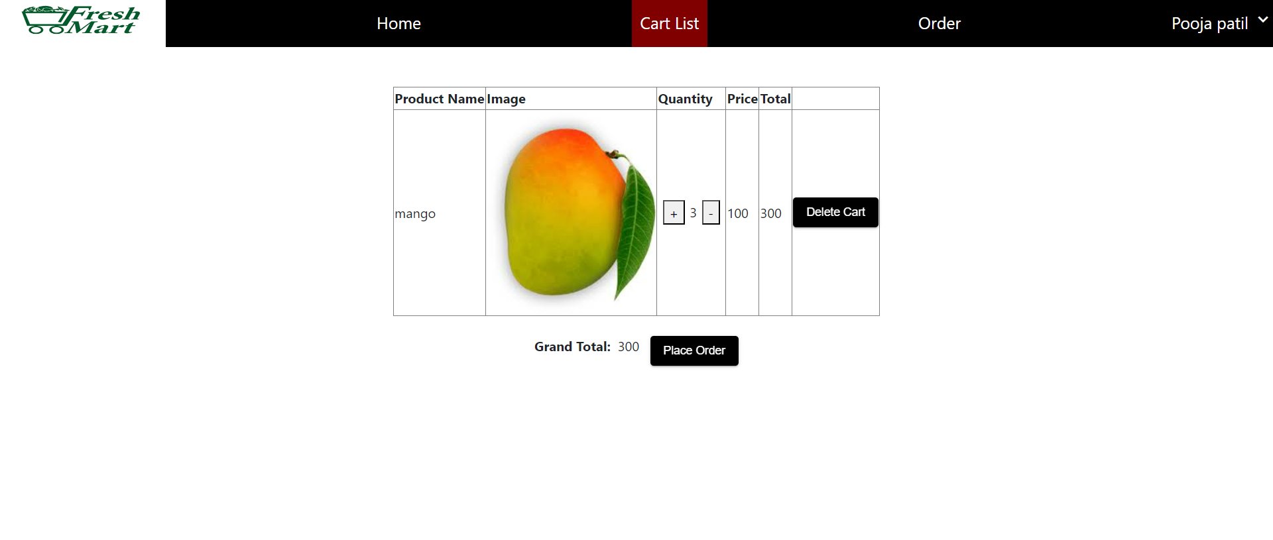
Output
Client Signup & Login - Client Home & Cart list -

Slide 20
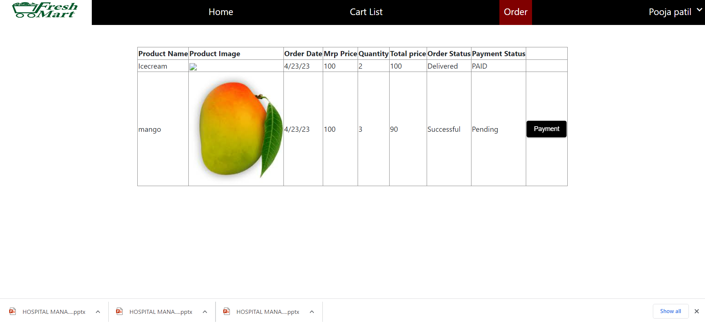
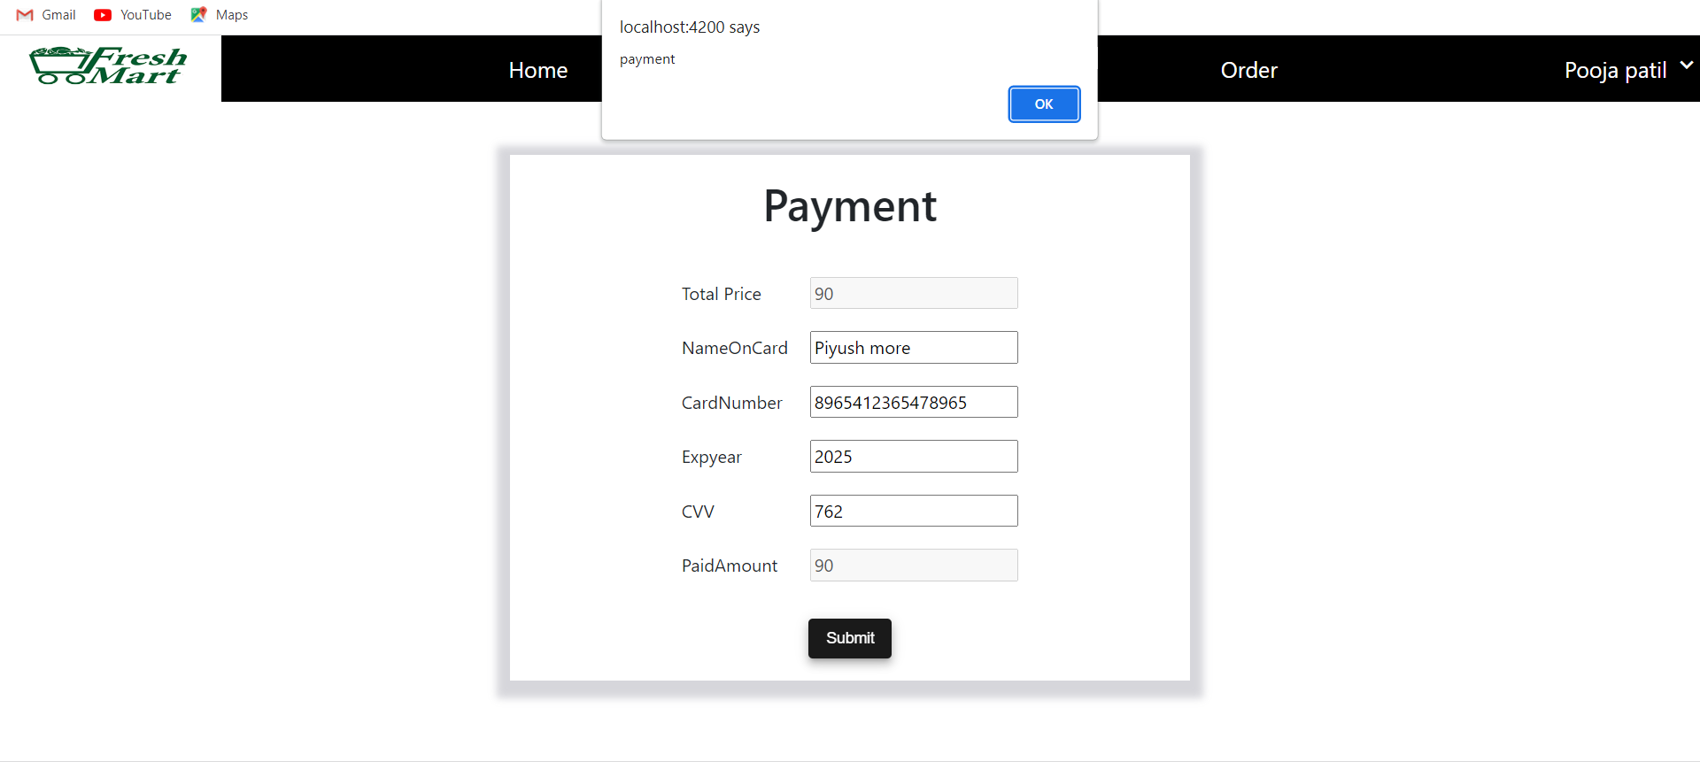
Output
Add Order – Payment -

Slide 21
Advantages -
Big Companies are Snatching Your Profits.
Seamless Payment Options.
Understanding Customers Psychology.
Unbelievable Profitable Inventory Management Options.
Your Customers are Getting Smarter.
Earn More From Customers, Pay Less to Wholesalers.

Slide 22
CONCLUSION
Online grocery services meet a number of consumer needs including providing products for niche markets or helping the time starved consumer shop for the mundane weekly groceries. By delivering products to consumers' homes, the homebound aged and handicapped can participate in the shopping experience. Even though there has been a great decline in the number of pure-play online stores, there appears to be a solid market for shopping online. The major business model that is working today requires the support of the established bricks-and-mortar supermarkets. This model is effective as it creates distribution efficiencies and leverages reputation, which is an important consideration for consumers in light of the perishable nature of many grocery products.

Slide 23
THANK YOU

